Slide 1
Malacology 101: Hard Talk on a Soft Topic
Bruce Neville
Conchologists of America
27 July 2015
Notes:
Distinguish malacology vs. conchology

Slide 2
What is a Mollusk?

Slide 3
Why Should I Care About Mollusks I? Biology
Greater range of body size than any other phylum
Among the longest-lived animals
Live in most extreme habitats
Magnetic teeth
Gold plated animals
Incorporate chloroplasts, nematocysts
Intelligence
Camouflage
Maternal care
Sex changes

Slide 4
Why Should I Care About Mollusks II? Human Aspects
Human food items
Many endemic and endangered species
Some highly invasive species/pests
Involved in life cycles of major human parasites
Some are venomous to humans
Drill into wood and solid rock
Mathematical precision of shells
Pearls
Use as currency
Religious symbolism
Tyrian purple
Collectors

Slide 5
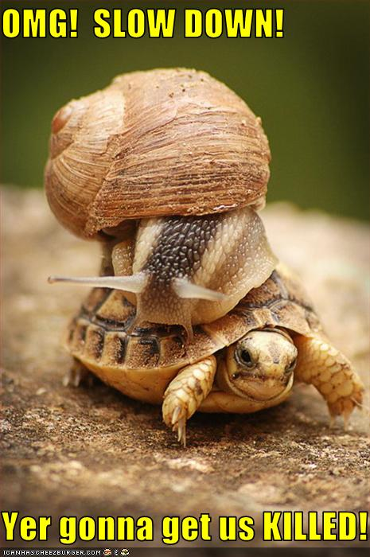

Slide 6
Okay, so what IS a mollusk?
No single defining character
Generally have an external shell
That is secreted by a mantle
That protects a non-segmented body
That is divided into an anterior head region, a ventral foot region, and a dorsal visceral mass
Equipped with a radula
That grew from a trochophore and a veliger larva
Notes:
Other things have shells, but are not mollusks: barnacles (once considered mollusks), sea urchins, turtles, armadillos.

Slide 7
The Mantle
Cypraea tigris Linnaeus 1758
Photo: pakmat, WikiCommons, Creative Commons license.

Slide 8
The Radula
Diagram of radular action.
Creator: Debivort (?), WikiCommons, GNU Free Documentation License.
http://youtu.be/mLVDwlrSq5U
Scanning Electron Micrograph of Radula of Abyssochrysos sp.
Photo: Richard S. Houbrick, WikiCommons, public domain.
Notes:
Note youtube video on handout. When you watch it, also notice how the foot is used in movement.

Slide 9
Relative Number of Species by Class
Notes:
Relationships among the groups are not well worked out. 2011 paper proposed dramatic rearrangment.

Slide 10
Caudofoveata and Solenogastres
Two major groups:
Glistenworms
Solenogasters
About 300 species
All species marine
Poorly known
Radula is present
Spicules, but no shell
Burrowing micro-predators (glistenworms) or epizoic carnivores (solenogasters)
Epimenia verrucosa (Nierstrasz 1902)
Photo: Show_ryu, WikiCommons, GNU Free Documentation License
Notes:
Ancestral mollusk now thought to have resembled a solenogaster.

Slide 11
Polyplacophora
Chitons
About 750 species
All species marine
Eight shell plates plus spicules
Live in rocky habitats
Scrape algae from rocks
Radular teeth with magnetic iron cusps
Thought to be used in homing behavior
Tonicella lineata (Wood 1815)
Photo: Magnus Manske, WikiCommons, public domain.

Slide 12
Monoplacophora
“Monos”
All 30+ species marine, deep-water
No Texas species found (yet)
One shell piece
“Pseudo-segmentation”
thought to be detritus feeders or predators on microorganisms
Monoplacophoran, probably Neopilina galatheae Lemche 1957
Photo: Veronidae, WikiCommons, creative commons license.
Notes:
No common name.
Lazarus vs. Elvis taxa.
Living species may be degenerate chitons, rather than ancestral gastropods.

Slide 13
Scaphopoda
Tusk shells
About 600 species
All marine
Tapered, cylindrical shell, open at both ends
Biology not well known
Live buried in sand
Feed on small animals captured by specialized tentacles
Antalis entale (Linnaeus 1758)
Photo: Georges Jansoone, WikiCommons, Creative Commons.

Slide 14
Cephalopoda
Octopuses, squids, cuttles, nautiluses
About 700 species
All marine
Only nautiluses have true shell
Some have internal “shell”
Radula present within horny beak
Highly concentrated nervous system
Highly mobile
Male copulatory organ is a modified tentacle
Nautilus pompilius Linnaeus 1758.
Photo: Lee R. Berger, WikiCommons, Public domain.
Notes:
No etymological basis for “octopi.”
Chambers of nautilus connected by fleshy siphuncle, which absorbs and secretes gases to regulate buoyancy.

Slide 15
Bivalvia
Clams, mussels, scallops, oysters, cockles, shipworms, etc.
Formerly called Pelecypoda
About 10,000 species
Marine and freshwater
Two shell valves, left and right
Lack a radula
No defined brain
Filter feeders
Tridacna gigas (Linnaeus 1758)
Photo: Mila Zinkova, WikiCommons, GNU Free Documentation License.

Slide 16
Anatomy: Bivalves
Stolen from: Abbott, R. T. (1986). Seashells of North America: a guide to field identification (Rev. ed.). New York: Golden.
Notes:
Point out adductor muscles.
Food path from inhalant siphon, filtered through gills, passed to mouth in mantle cavity, to rectum, and voided through exhalant siphon.
Note that there is no ganglion or “brain” in the figure.

Slide 17
Gastropoda
Snails, slugs, limpets, abalones, conchs, whelks, sea hares, nudibranchs, etc.
About 100,000 species
Marine, freshwater, and terrestrial
One or zero shell valves
Operculum may or may not be present
Asymmetrical
Godiva quadricolor (Barnard 1927).
Photo: Nick Hobgood, WikiCommons, Public domain.
Notes:
One family has secondarily evolved a bivalved shell.

Slide 18
Anatomy: Gastropods
1 Shell
2 Liver
3 Lung
4 Anus
5 Respiratory pore
10 Mouth
13 Genital pore
19 Foot
23 Heart

Slide 19
The Shell
Tonna dolium (Linnaeus 1758)
X-ray photo: Dr. Michael Royon, WikiCommons, GNU Free Documentation License.
Notes:
Point out: protoconch, logarithmic growth in 3 dimensions, columella

Slide 20
Asymmetry
Amphidromus perversus (Linnaeus 1758)
Photo: Marcus Coltro, Femorale, used with permission.
Notes:
Sinistrality and ambidextrous-ness is more common in terrestrial species; must be less selective pressure.
Interesting genetics, worked out with common European pond snail, Lymnaea stagnalis.
Asymmetry in bivalves! Wave-sorting.

Slide 21
Number of Species by Habitat

Slide 22
Feeding
Exploit almost every potential food source
Chitons are generally herbivorous.
Scaphopods are micro-predators.
Cephalopods are pursuit predators.
Gastropods may be herbivorous, carnivorous, detritivorous, or parasitic.
Bivalves are detritivores, filter-feeders, or carnivores.
Notes:
Feeding is one of three main tasks of any living thing. The other two are avoiding being eaten (see octopus video in handout) and reproduction.

Slide 23
Reproduction
Sexes separate or hermaphrodites
Hermaphrodites may be sequential or simultaneous
Fertilization may be internal or external
Spiral cleavage (we have radial cleavage)
Some gastropods and bivalves brood juveniles in mantle cavity
Some cephalopods have elaborate maternal care
Larvae may be planktonic or crawl-away
Freshwater mussels have parasitic glochidium larva
Pulmonate eggs may be calcified
Notes:
Spiral cleavage is shared with annelids and arthropods. Opposite of spiral cleavage is radial (echinoderms and chordates).
Cephalopods lack a trochophore and larval stage; development is completed within the egg.

Slide 24
Reproduction: Sequential Hermaphroditism
Crepidula fornicata (Linnaeus 1758)
Photo: Paul Morris, WikiCommons, Creative Commons license.
Notes:
“fornicata” does not mean what you think it does.
Pheromonal control of sex.

Slide 25
Trochophore and Veliger Larvae
Diagram of a Trochophore Larva
Creator: Xvasquez, WikiCommons, Public domain.
Diagram of the Veliger of Fiona pinnata (Eschscholtz 1831)
Casteel, D.B. (1904). “Cell lineage and early larval development of Fiona marina, a nudibranch. Proc. Acad. Nat. Sci. Philadelphia 1(6):325-405, pl. 35, fig. 110.

Slide 26
Human Uses
Use as Food
US catch, 2006
~195,000 tons
value $775,688,000
Main species: squid (roughly half), surf clams, sea scallops, oysters, quahog
World production, 2006
Wild caught: 7.6M metric tonnes, over half cephalopods
Aquaculture: 14.1 metric tonnes, mostly clams and oysters

Slide 27
Killer Snails

Slide 28
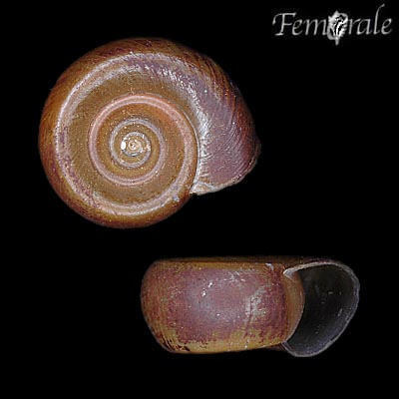
Human Diseases
Schistosome Life Cycle Diagram by U.S. Dept. of Health and Human Services: http://commons.wikimedia.org/wiki/File:Schistosomiasis_Life_Cycle.png
Biomphalaria glabrata (Say 1818)
Photo: Marcus Coltro, Femorale, used with permission.
Notes:
Yet another youtube video I can’t show: cone snail eating a nemo. In real time.

Slide 29
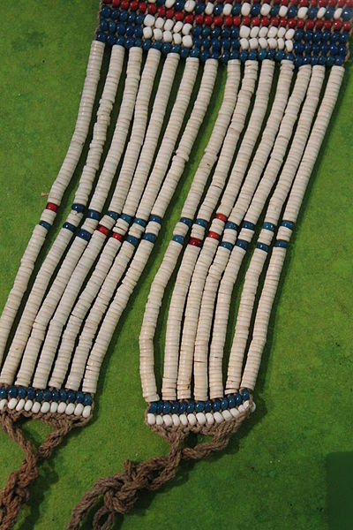
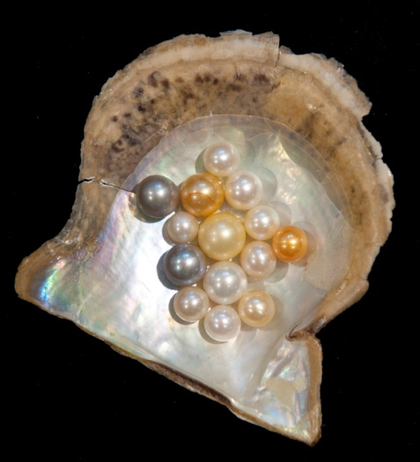
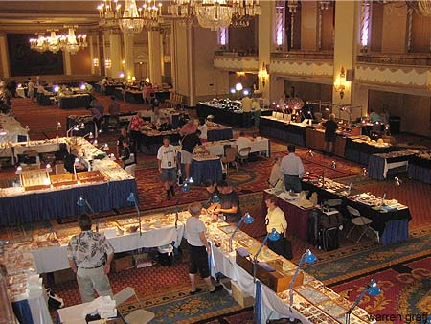
Other Human Uses
Credits. Botticelli “Birth of Venus,” Public domain. Shell money: Geldschnur Überseemuseum, WikiCommons, Creative Commons. COA Bourse: uncredited, www.conchologistsofamerica.com. Pearls: Hannes Grobe, WikiCommons, Creative Commons.
Notes:
Other uses, Tyrian purple, religious symbolism (chank), pets.

Slide 31
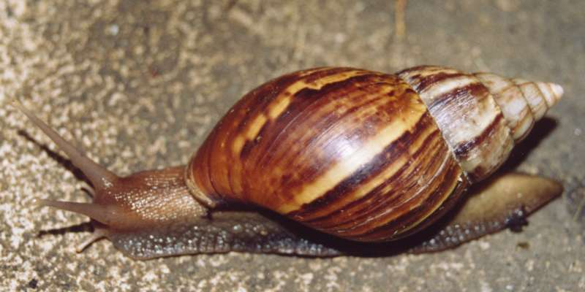
Invasive Species I: Hawaii
Achatina fulica (Férussac 1821) in Thailand
Photo: Ahooerstemeier, WikiCommons, GNU Free Documentation License.
Notes:
Introduced from a specimen brought in as a pet. Escaped and began munching on neighbors’ gardens, so it must be controlled.

Slide 32
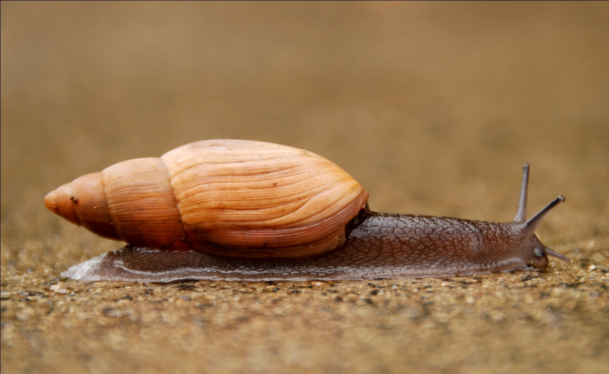
Invasive Species I: Hawaii
Achatina fulica (Férussac 1821) in Thailand.
Photo: Ahooerstemeier, WikiCommons, GNU Free Documentation License.
Euglandina rosea (Férussac 1821) in Hawaii.
Photo: Dylan Parker, WikiCommons, Creative Commons License.
Notes:
What better way to control an herbivore than to introduce a voracious carnivore from the Southeastern US?

Slide 33
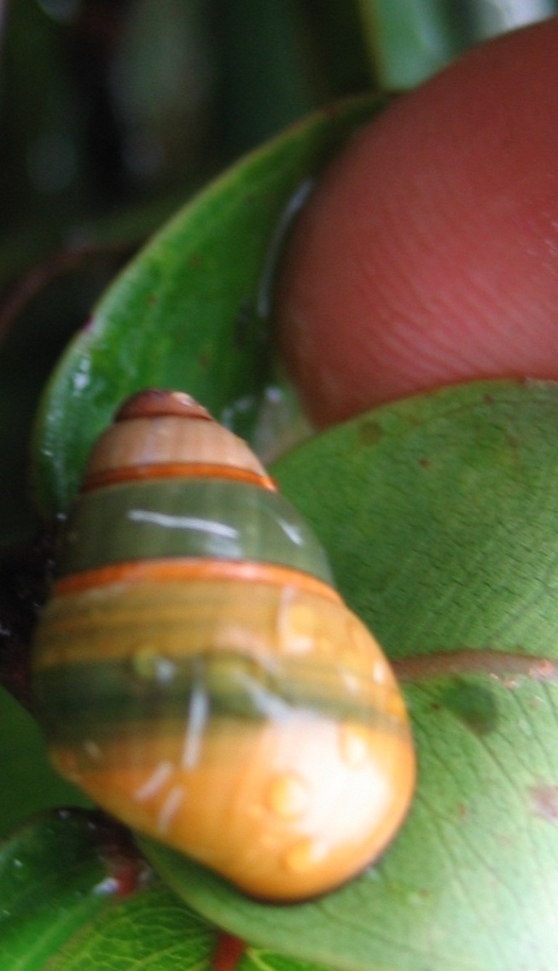
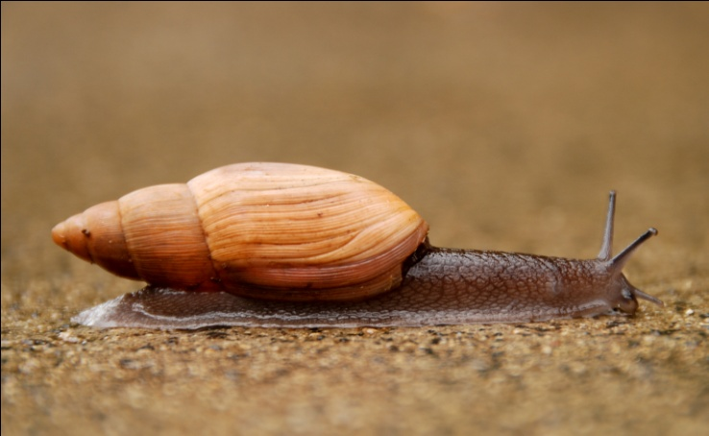
Invasive Species I: Hawaii
Achatina fulica (Férussac 1821) in Thailand.
Photo: Ahooerstemeier, WikiCommons, GNU Free Documentation License.
Euglandina rosea (Férussac 1821) in Hawaii.
Photo: Dylan Parker, WikiCommons, Creative Commons License.
Achatinella lila Pilsbry & Cooke 1913.
Photo: Stefanie GArdin, US Army, WikiCommons, Public domain.
Notes:
Which, unfortunately, developed a taste for the local escargot. All species of Achatinella are now listed as extinct or highly endangered.

Slide 34
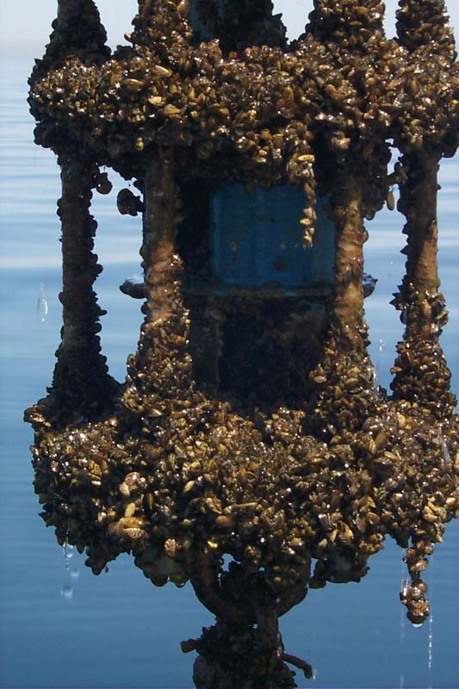
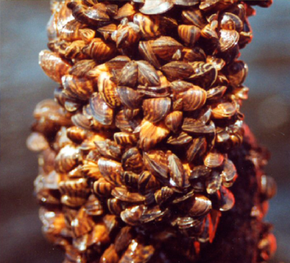
Invasive Species II: Zebra Mussel
Zebra Mussel, Dreissena polymorpha (Pallas 1771).
Three variations: USGS, WikiCommons, Public domain.
Close-up cluster: Shirley & Kark, WikiCommons, Creative Commons License.
Encrusted buoy: M. McCormick, WikiCommons, Public domain.
Notes:
Competes by monopolizing all available settling surfaces, even settling on indigenous bivalves and smothering them.
Astronomical reproductive rates.

Slide 35
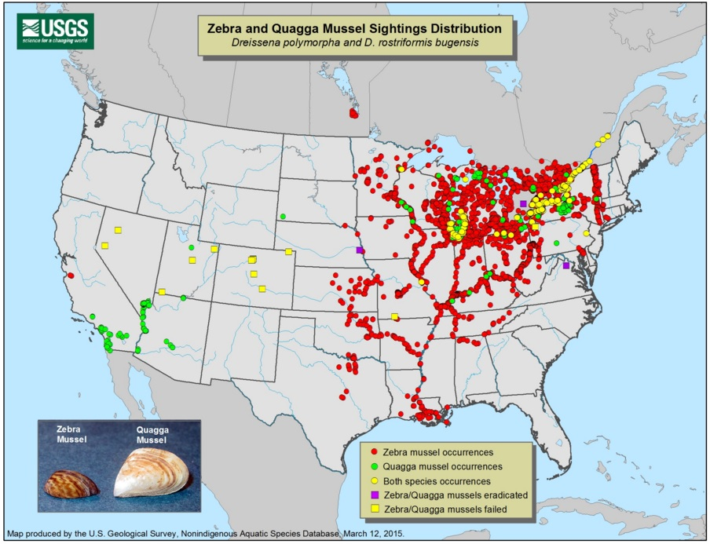
Invasive Species II: Zebra Mussel
First detected in the US in the Great Lakes in 1988.
Collected in Lake Texoma, April 2009.
Collected in Lake Ray Hubbard, 2009.
Collected in Belton Lake, IN THE BRAZOS RIVER BASIN, 18 Sept. 2013.
Source: http://nas.er.usgs.gov/taxgroup/mollusks/zebramussel/maps/current_zm_quag_map.jpg.

Slide 36
Anatomy: Gastropods
1 Foot
2 Cerebral ganglion (“brain”)
5 Osphradium (chemosensory organ)
6 Gills
7 Pleural ganglion
8 Atrium of heart
9 Visceral ganglion
10 Ventricle of heart
12 Operculum
14 Mouth (unnumbered green line is radula)
16 Eye
17 Penis (normally inverted)
19 Pedal ganglion
23 Parietal ganglion
24 Anus
25 Hepatopancreas (“liver”)
26 Gonad
28 Nephridium (“kidney”)
Notes:
Mention protoconch.
Mention torsion. NOT related to coiling into shell. Results in figure-8 nerve cord. Brings anus to right above mouth!

Slide 37
Rare & Endangered Species
“With 302 species and 11 subspecies listed as extinct [since 1850], mollusks are the group paying the most severe documented tribute to the crisis according to IUCN figures (302 vs. 271 for all terrestrial vertebrates).”
Regnier, C., B.Fontaine & P. Bouchet (2009). Not knowing, not recording, not listing: numerous unnoticed mollusk extinctions. Conservation Biology 23(5):1214-1221.

Slide 38
Rare & Endangered Species
Reasons:
Habitat destruction
Introduced species
Pollution
Limited distributions
Federal:
37 snails (2 marine, 11 terrestrial, 24 freshwater)
72 clams (all freshwater mussels)
Texas:
1 snail (Assiminea pecos),
15 freshwater mussels

Slide 39
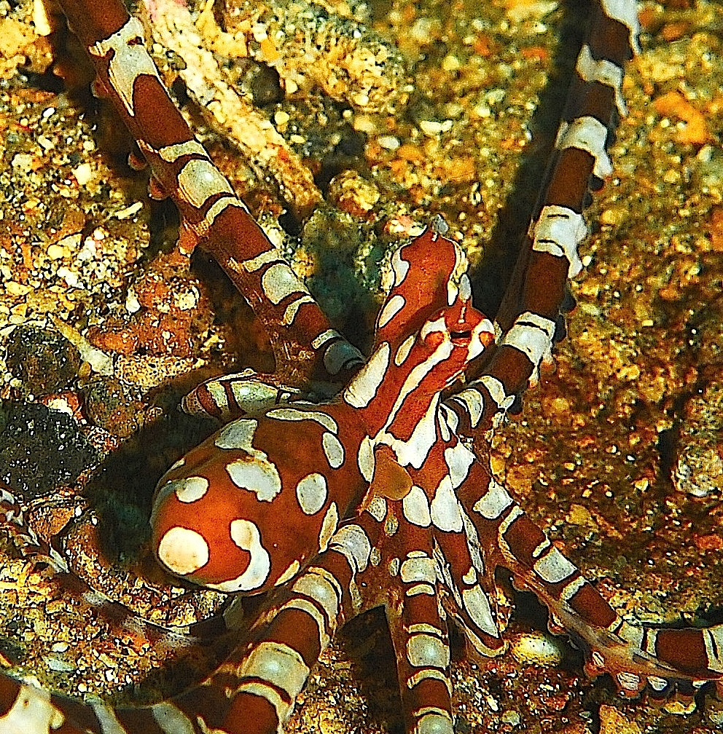
Thank you. Questions?
Wonderpus photogenicus Hochberg, Norman & Finn 2006.
Yes, that’s it’s real name.
Photo: Jenny Huang, WikiCommons, Public domain.

