Slide 1
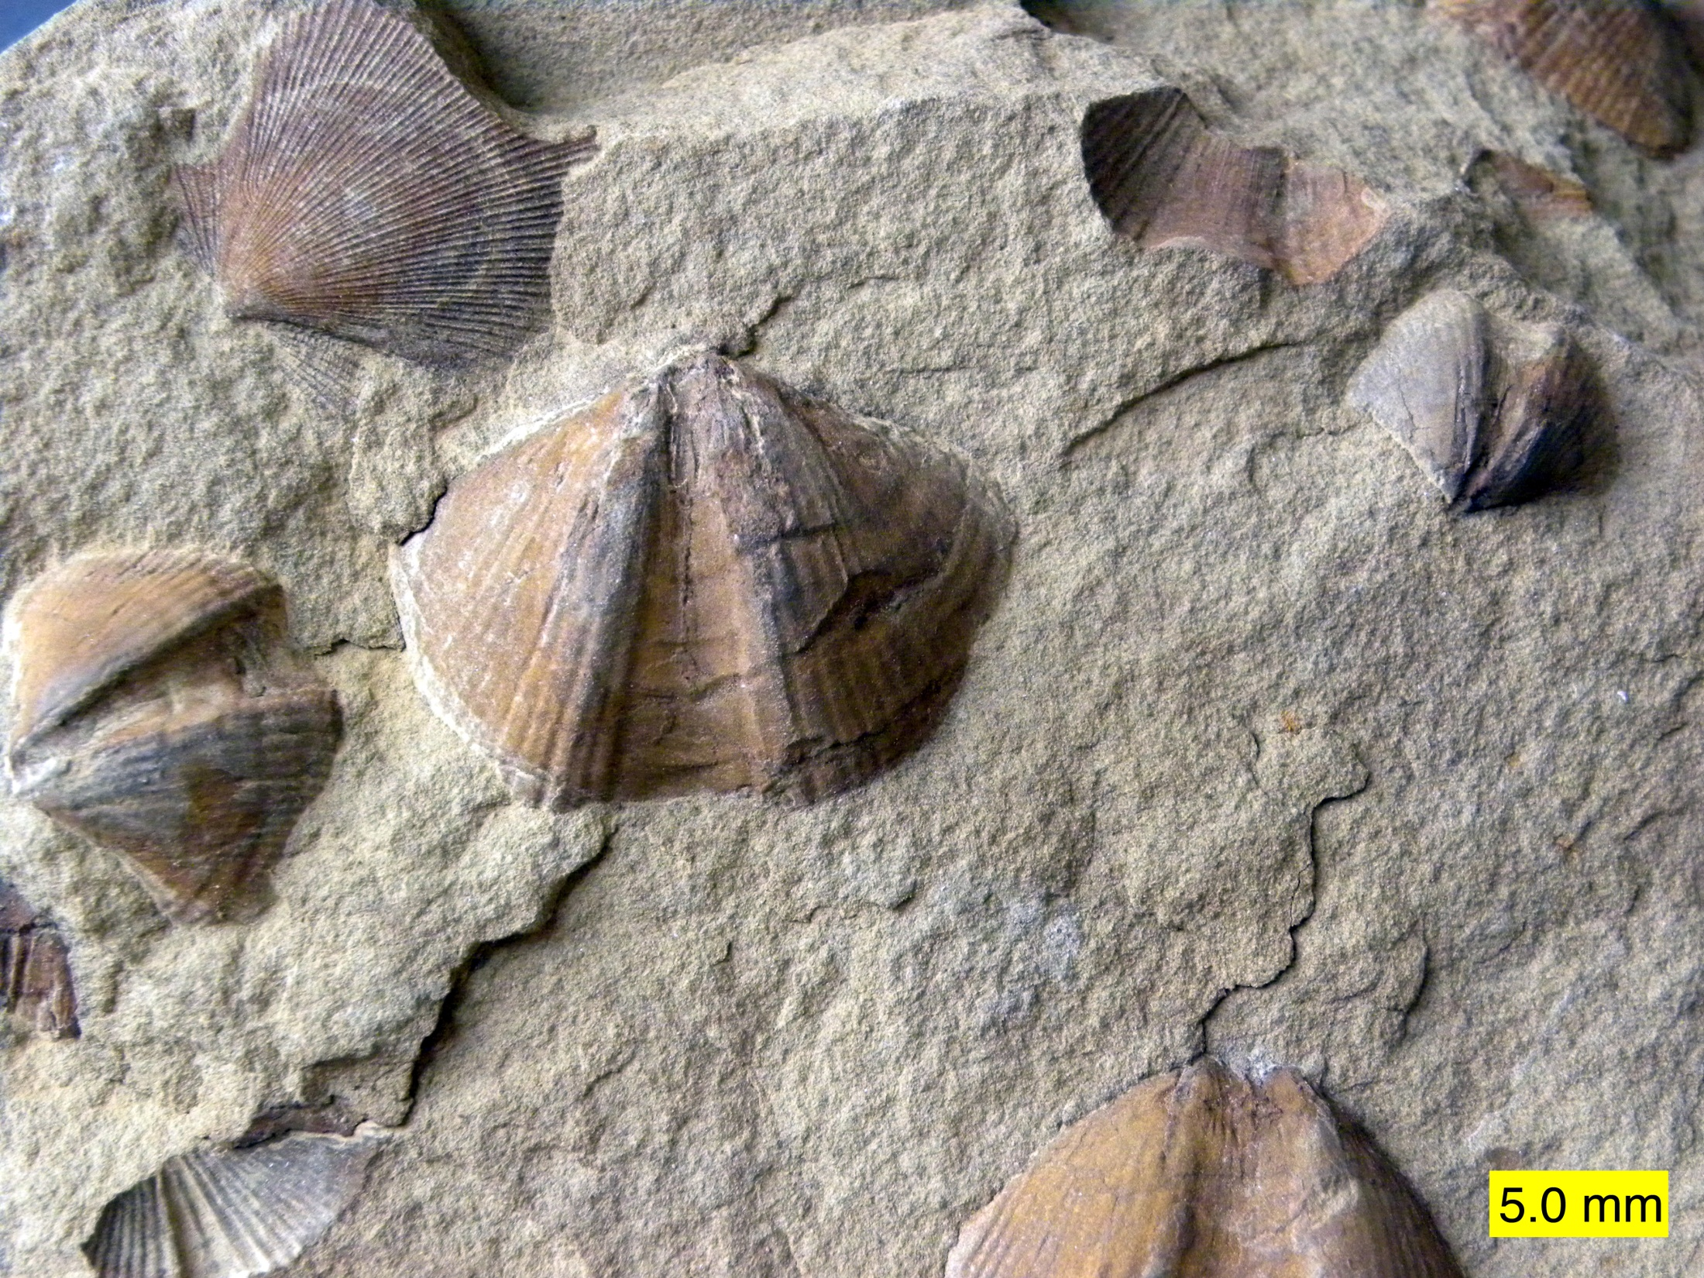
Brachiopods “The Other Bivalves”
Bruce Neville
Houston Conchology Society
21 November 2021
Syringothyris sp. and Aviculopecten sp., Logan Formation, Lower Carboniferous, of Wooster, Ohio.
Photo credit: Wilson 44691, http://commons.wikimedia.org/wiki/File:LoganFauna011312.jpg, Wikicommons Creative Commons Share Alike license.
Notes:
My interest in “orphan” groups.
Turns out they’re pretty boring.

Slide 2
What is a bivalve?
Photo credit: Pearson Scott. http://commons.wikimedia.org/wiki/File:Bivalve-univalve_%28PSF%29.jpg. Public domain.
Notes:
Bivalve condition has arisen multiple times in evolution.

Slide 3
critters with two shells
Mollusks
(Bivalvia)
Placopecten magellanicus
(Gmelin 1791)
Photo credit: Dann Blackwood, USGS. http://commons.wikimedia.org/wiki/File:Placopecten_magellanicus.jpg. Public Domain.
Notes:
Most widely known are the bivalved mollusks, which have commandeered the name “bivalve.”

Slide 4
critters with two shells
Seed Shrimps (Crustacea: Ostracoda)
Euphilomedes climax
Kornicker 1991
Photo credit: NOAA. http://commons.wikimedia.org/wiki/File:Ostracoda.jpg. Public domain.
28PSF%29.jpg
Notes:
Tiny crustaceans, a few mm long.

Slide 5
critters with two shells
Water Fleas
(Crustacea: Cladocera)
Ceridaphnia sp.
Photo credit:
Kruczy89. http://commons.wikimedia.org/wiki/File:Ceriodaphnia.jpg. Creative Commons, Share Alike.
Notes:
Another group of tiny crustaceans, also a few mm long.

Slide 6
critters with two shells
Snails
(Gastropoda: family Juliidae)
Edenttelina chloris
(Dall 1918)
Art credit:
Abbott, R. Tucker, 1968. Seashells of North America. New York: Golden. p. 172.
Notes:
Even snails have developed a bivalved version! True nature was not discovered until 1959, when living specimens were collected off Japan. Saccoglossan opisthobranchs. Since many people have never seen one, I’ve included a specimen in the show and tell. Begin life with a swimming coiled univalved operculate shell. When it finds a suitable alga, it settles, sheds its operculum, and the teleoconch splits. By four days post-hatching, it has a fully functioning hinged bivalved shell! When you think about it, the operculum is a functional “second valve.” STOP! The bivalve condition is not limited to animals. Tell story of “clams” from Betty. Now move on.

Slide 7
critters with two shells
Family Anacardiaceae
(Plantae)
Pistachia vera
L., 1753
Photo credit:
Scott Bauer, USDA. http://commons.wikimedia.org/wiki/File:ARS_pistachio.jpg. Public domain.
Notes:
STOP! Ask what the examples have in common, besides two valves. Looking for laterality. Now move on.

Slide 8
critters with two shells
Brachiopods
(Phylum Brachiopoda)
Terebratalia transversa
(G.B. Sowerby I, 1846)
Photo credit: R. Philippi.
http://commons.wikimedia.org/wiki/File:Terebratalia_tranverse.jpg. Creative Commons, Share Alike.
Notes:
Previous (not sure about pistachios) have all had left-right valves. Brachs are still left-right symmetrical, but valves are dorsal and ventral. Scallop, shown for bivalve mollusks has functional dorsal and ventral valves, but they are still left and right, and they lie on their sides, like flounders.

Slide 9
shell orientation
Art credit: Shrock, R.R., & W.H. Twenhofel, 1953. Principles of invertebrate paleontology, 2nd ed. New York: McGraw-Hill. Fig. 9-2, p. 263.
Notes:
Discuss plane of symmetry and relation to valves.

Slide 10
critters with two shells
Turtles
(Phylum Chordata,
Class Reptilia)
Terrapene carolina triunguis
(Agassiz 1857)
Photo credit: “Carnopod.”
http://commons.wikimedia. org/wiki/File:Three-toed_Box_Turtle.jpg. Public domain.
Notes:
One final example of a bivalve, again with a dorso-ventral shell. This is actually a TRI-valve, with the main valves fused and the ventral valve secondarily divided to enclose the soft parts within the shell.

Slide 11
comparison: bivalve mollusks v. brachiopods
Bivalve Mollusks | Brachiopods
Left and right valves | Dorsal and ventral valves
Shell is secreted by a mantle | Shell is secreted by a mantle
Mantle edge with three lobes | Mantle edge with two lobes
Shell without punctae | Shell with or without punctae
Valves open with elastic ligament | Valves open by muscle action
Breathe and feed with gills | Breathe and feed with lophophore
Attach (when they do) by a fibrous byssus | Attach by a muscular or fibrous pedicle
Notes:
Have not found information on histological or physiological processes of respective mantle. Will discuss lophophore and pedicle (also called peduncle) later.

Slide 12
Paleontological distribution
Art credit: Shrock, R.R., & W.H. Twenhofel, 1953. Principles of invertebrate paleontology, 2nd ed. New York: McGraw-Hill. Fig. 9-58, p. 341.
Notes:
Fully formed at the beginning of the Cambrian, when shelled fossils first arose. Have not been confirmed in pre-Cambrian, but without shell, how could you recognize a brach? Over 1600 fossil genera and >30K fossil species, compared to about 60 genera and 300-350 species today. Lingula is one of oldest genera, going back to Devonian, ca. 350 mya, but no living species goes back that far.

Slide 13
A cambrian seabed
Diorama from the Museum Mensch und Natur in Münschen
Photo credit: Ghedoghedo, http://commons.wikimedia.org/wiki/File:Cambrian_sea.JPG. Creative Commons, share alike
Notes:
Obligatory Cambrian diorama. Brachs are green spiriferids and orange discinids. Tall sponge-like structures are archaeocyathids. Trilobites. Brown “fishies” are Sidneyia (an arthropod of uncertain affinity), red “shrimps” are Candaspis. Blackish thing in lower left looks like Opabinia, a Burgess Shale creature of unknown affinity and no living relatives.

Slide 14
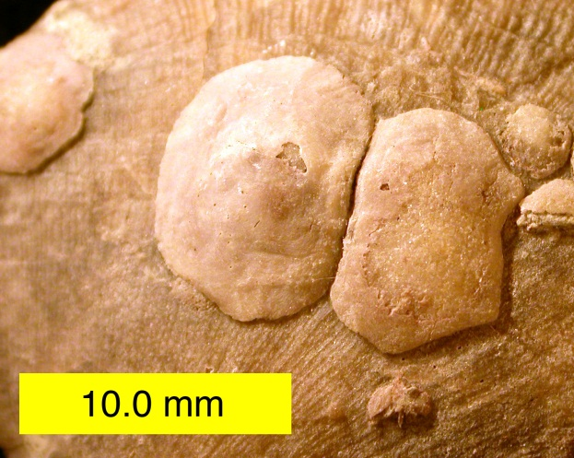
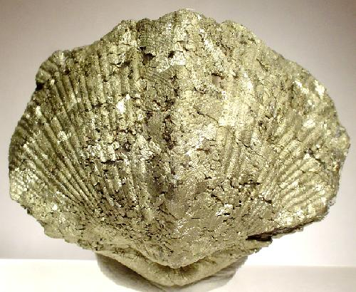
Fossil brachiopods
Upper Left: Petrocrania sp., Upper Ordovician, Indiana
Upper Right: Mucrospirifer sp.
Lower Left: Pyritized brachiopod, Devonian, Ohio.
Photo credits: UL Mark Wilson, http://commons.wikimedia.org/ wiki/File:PetrocraniaOrdovician.jpg, Public domain.
UR: DanielCD, http://commons.wikimedia.org/wiki/ File:MucrospiriferSp.jpg, GNU Free Documentation.
LL: Rob Lavinsky, http://commons.wikimedia.org/ wiki/File:Pyrite-41441.jpg, Creative Commons, share alike.
Notes:
Upper left, a craniid, which attaches by cementing to the underlying substrate, which in this case is an articulate brachiopod. Upper right, Mucrospirifer; wings allow it to live in relatively soft sediments without sinking into the sediments. Lower left: pyritized specimen. When a calcified shell is present, it is as calcite, not aragonite, so it is not displaced on fossilization.

Slide 15
Where do brachiopods fit in the “tree of life”?
Art credit: Online Textbook at http://biologytb.net23.net/text/chapter23/concept23.9.html
Notes:
So, where do the brachiopods fit among the other groups of animals?

Slide 16
What is a BRAChiopod?
Notes:
Brachiopods are a phylum, or basic “body plan” of animals. Approximately 35 phyla, depending on who’s counting. All but one are “invertebrates.” Here are the relative numbers of living species by phylum. Note that Brachiopoda is not among them. See that little sliver at the top? That’s the other 24 phyla lumped together. Let’s break that little sliver down.

Slide 17
Brachiopoda’s place among the “minor” phyla
Notes:
Here are the 24 phyla represented by that little sliver in the previous chart. Brachiopoda has been “exploded.” About 335 living species, according to the source where I got these figures. To put that into perspective, there are about 10K spp of bivalved mollusks, about 750 species of chitons, about 700 species of cephalopods, and about 600 species of scaphopods. Note that I ran out of room in the legend to list all of the phyla; there are two phyla (Placozoa and Cycliophora) with only 1 species each.

Slide 18
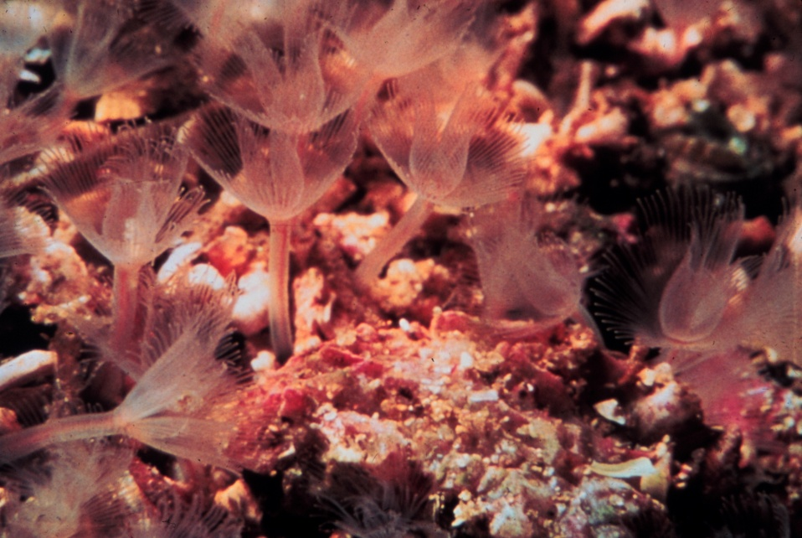
what are the brachiopods’ closest relatives?
Phoronida
Art Credits:
Left: Haeckel, Ernst, 1899. Kunstformen der Natur. Plate 23. http://commons.wikimedia.org/wiki/ File:Haeckel_Bryozoa.jpg.
Right: Phoronis architecta (Andrews 1890). Achmin Raschka, National Undersea Research Project. http://commons.wikimedia.org/wiki/File:Nur03506.jpg. Public domain.
Bryozoa
Notes:
One early name for brachiopods was “anomie”; Linnaeus placed the known brachiopods in his genus Anomia, which is the jingle shell, though of 27 names, 6 are Anomia, 1 is an oyster, 4 are living brachiopods, and 16 are fossil brachs. The name Brachiopoda is credited to Duméril in 1807. “Brachium” is arms; it was thought that the “arms” of the lophophore were mobile, like a molluscan foot, so could be extended to move the animal about. Turns out to be false. Orbigny developed the idea of a group “Molluscoidea,” to include the brachiopods, bryozoans, barnacles, and tunicates. This concept lasted well into the early 20th century. If you look at “mollusk” papers from that time, they will also include brachs and barnacles, and sometimes tunicates. But we’ve already seen that brachs are functionally very different from clams. The lophophore is an elaborate structure that ties together the three phyla Bryozoa, Phoronida, and Brachiopoda. Brachs’ closest relatives are probably the shell-less, wormlike phoronids. In the great “tree” of invert life, there are two main branches: protostomes (arthropods, annelids, and mollusks) and deuterostomes (echinoderms and chordates). The lophophorates, of course, show characteristics of both groups, so they are either basal to both or perhaps near where the deuterostomes diverged from the protostomes. There is some evidence now that bryozoa are closer to mollusks, leaving phoronids and brachs as mutually closest relatives.

Slide 19
Living brachiopods
Brachiopods on boulder on sea floor, off Massachusetts, probably Hemithiris psittacea (Gmelin 1790) and Terebratulina septentrionalis (Couthouy 1838)
Photo credit: USGS, http://commons.wikimedia.org/wiki/File:Usgs_boulder_brachiopods.jpg. Public domain.
Notes:
Where brachiopods occur, they can be abundant. This was taken off Massachusetts, depth not known. Hemithiris has a U-shaped dorsal valve, see lower right. Terebratulina is more classically “clam-like,” as at upper center.

Slide 20
An inarticulate brachiopod
Lingula anatina Lamarck 1801, showing pedicles
Photo credit: OpenCage, http://commons.wikimedia.org/wiki/File:Lingula_anatina.jpg. Creative Commons, share alike
Notes:
It is traditional and convenient to divide brachiopods into two groups: articulates and inarticulates. Both were present among the earliest fossils, so neither is more “primitive” than the other. The inarticulates lack a hinge, and the valves do not interlock (or articulate). It was pointed out that Lingula (Latin for “tongue”) is a strange name for an “inarticulate” creature. Note the pedicles in this photo of living Lingula in an aquarium.

Slide 21
An inarticulate brachiopod in life
Art Credits: Philcha. http://commons.wikimedia.org/wiki/File:Lingulid_burrow_01.png. Public domain.
Notes:
Lingula lives in a burrow, like many bivalved mollusks, anchored by the pedicle. The pedicle can be contracted to withdraw the animal into the safety of the burrow. They are capable of limited movement and reburial. Do not have siphons, like bivalved mollusks, but create inhalant and exhalant currents with lophophore and bundles of setae that extend beyond margin of shell.

Slide 22
An articulate brachiopod
Gwynia capsula (Jeffreys 1859),
on Striarca lactea (Linné 1758)
Photo credit: Hans Hillwaert, http://commons.wikimedia.org/wiki/File:Gwynia_capsula_%26_polychaete.jpg. Creative Commons, share alike.
Notes:
Articulate brachiopods “articulate” with a hinge bearing teeth and sockets. The large shell is not a brachiopod, but a bivalved mollusk. Given the species, it is probably about an inch across. The brachs are the little specks attached, and enlarged here.

Slide 23
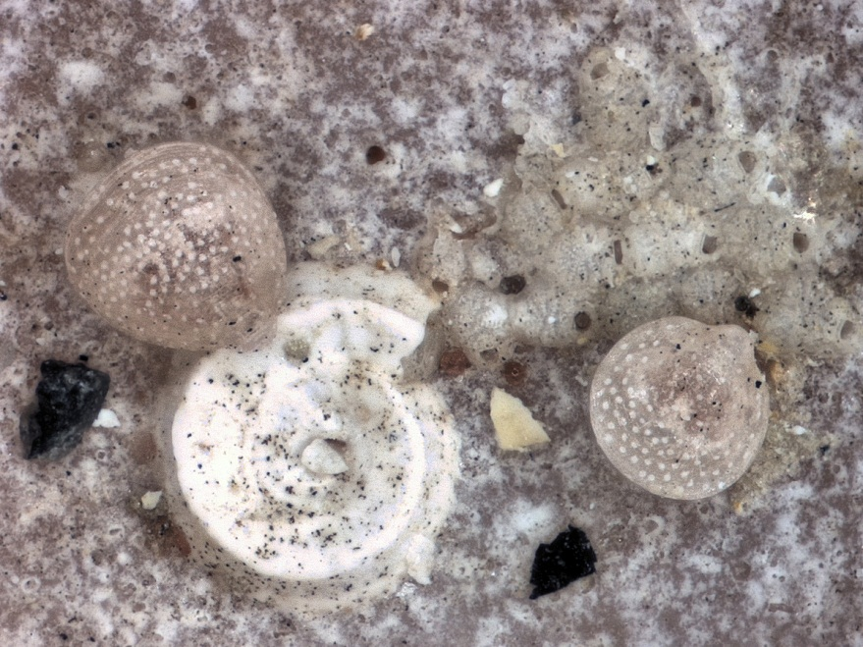
An articulate brachiopod
Gwynia capsula (Jeffreys 1859),
on Striarca lactea (Linné 1758)
Photo credit: Hans Hillwaert, http://commons.wikimedia.org/wiki/File:Gwynia_capsula_%26_polychaete.jpg. Creative Commons, share alike.
Notes:
Articulate brachiopods “articulate” with a hinge bearing teeth and sockets. The large shell is not a brachiopod, but a bivalved mollusk. Given the species, it is probably about an inch across. The brachs are the little specks attached, and enlarged here, along with a polychaete tube. These Gwynia are full grown at about a mm across.

Slide 24
An articulate brachiopod in life
Art credits: Popular Science Monthly, 1887. Wikicommons, http://commons.wikimedia.org/wiki/File:PSM_V31_D767_Anatomy_of_a_brachiopod.jpg. Copyright expired.
Notes:
Here is a drawing of two species of articulate brachiopods in life. This is from an old (1887) drawing, which confuses developmental and functional dorsal and ventral. The ventral valve developmentally is the larger and bears the pedicle, while the dorsal valve developmentally is smaller and sits within the ventral valve. In life, however, the animal “sits on its head” with the “ventral” valve dorsal and the “dorsal” valve ventral! Hence the contorted pedicles seen here. Articulate pedicles cannot reattach, and the animals cannot move if pedicle is torn, will become buried. This also illustrates the common name of “lamp shell,” as the shell gives the appearance of an “Aladdin’s lamp.”

Slide 25
The brachiopod shell
Art Credits: Muriel Gottrop, 2005. http://commons.wikimedia.org/wiki/File:Brachiopoda-morphology.png. Creative Commons, share alike.
Notes:
Here is a diagram of an articulate brachiopod shell, showing the life position in more realistic perspective. Since fossil brachs are common and important in correlating stratigraphy, an elaborate nomenclature has developed of every little bump and fold on the shell. For our purposes, we can just worry about the dorsal (brachial) and ventral (pediclar) valves and the pedicle foramen.

Slide 26
punctae
Art credits: Left: Hans Hillwaert, http://commons.wikimedia.org/wiki/File:Gwynia_capsula_%26 _polychaete.jpg. Creative Commons, share alike. Right: Rudwick, M.J.S., 1970. Living and fossil brachiopods. London: Hutchinson Univ. Libr. Fig. 12, p. 42.
Notes:
Extensions of mantle tissue into channels in articulates. These are the same Gwynia from a previous slide. Punctae are visible as white spots on translucent shell. Punctae end blindly just under the periostracum. Function is unknown. Do not possess nerve cells, so are not “eyes.” May contain repellent chemicals.

Slide 27
What’s inside a brachiopod?
Art credit: Rudwick, M.J.S., 1970. Living and fossil brachiopods. London: Hutchinson Univ. Libr. Fig. 3, p. 19.
Notes:
Thayer calls them “minimal organisms.” The organic tissue forms only about 3% of the live weight of the animal and is crammed into the posterior portion of the shell. The rest (60-75%) of the shell is the mantle cavity, which is filled with the lophophore. Lophophore is an elaborate feeding and respiratory organ. There are two arms (brachia) that bear a ciliated food groove that convey food to the mouth located at the junction of the two brachia. Brachs are filter feeders and feed on small organic particles and dissolved organic matter. A few possibly take small plankters. The digestive system bears a mouth, esophagus, stomach, intestine, and (in inarticulates) an anus. The anus opens to the mantle cavity to the right of the midline and is one of the few breaks in strict left-right symmetry. In articulates, the intestine ends blindly, and waste products are expelled back out the mouth into the mantle cavity. The circulatory system is open. There is a weak heart above the stomach, but most movement of “blood” is by ciliary action of the body cavity. Excretion is by paired nephridia (two pairs in one group). Nervous system is simple, with subesophageal ganglion, circum-esophageal ring, and nerves to mantle, muscles, pedicle, and lophophore. No sensory organs developed, but sensitive to touch at mantle edge and shallow-water species respond to light and shadow, though no eyes are present.

Slide 28
Musculature of an articulate brachiopod
Art credit: Rudwick, M.J.S., 1970. Living and fossil brachiopods. London: Hutchinson Univ. Libr. Fig. 20, p. 57.
Notes:
Mentioned that both opening and closing are under muscular control. Closing accomplished by central adductor muscles, consisting of “quick” portion for rapid closure and “catch” portion for holding valves closed. Equivalent to the two parts of the adductor in a scallop. Unlike bivalved mollusks, diduction is by muscle attached to tip of dorsal valve, so action is to pull valves apart. Pedicle is a solid band of connective tissue. Movements limited to opening, closing, some rotation about pedicle. Opening is generally limited to a small vertical action, leaving a narrow gape.

Slide 29
Musculature of an inarticulate brachiopod
Art credit: Rudwick, M.J.S., 1970. Living and fossil brachiopods. London: Hutchinson Univ. Libr. Fig. 32, p. 69.
Notes:
Inarticulate brachiopods have no hinge and valves are not attached, except by animal tissue. Closing is accomplished by central adductor, again with quick and catch portions. Diduction is accomplished by a “posterior adductor.” Oblique muscles allow some rotation of valves. Pedicle is muscular and contains an extension of the body cavity, so is capable of contraction and limited worm-like movements.

Slide 30
The lophophore
Internal view of an articulate brachiopod, showing lophophore
Art credit: Chris Blanar, Flickr, CC-AT, NC, http://www.flickr.com/photos/chrisblanar/2126318392/.

Slide 31
The lophophore
Image credit: Temereva EN, Tsitrin EB (2015) Modern Data on the Innervation of the Lophophore in Lingula anatina (Brachiopoda) Support the Monophyly of the Lophophorates. PLoS ONE 10(4): e0123040. https:// doi.org/10.1371/journal. pone.0123040 cc-by
Notes:
Bears single row of ciliated cirri (or filaments) bordering a food groove.

Slide 32
Development of the lophophore
Art credit: Rudwick, M.J.S., 1970. Living and fossil brachiopods. London: Hutchinson Univ. Libr. Fig. 79, p. 133.
Notes:
Coiling of lophophore is not random “packing.” Three main patterns of folding, may represent optimal solutions to the packing. Lophophore can grow only at tip. All species start out with a simple trocholophe. Final stage in Gwynia. Doubles back to form schizolophe. Then can follow one of three paths. 1) Inner arm of schizolophe twists (transient zygolophe) then forms median spiral of plectolophe. 2) Two sides divide into multiple lobes, forming ptycholophe. 3) An ever-growing spiral forms a spirolophe.

Slide 33
the brachidium
Liospiriferina rostrata (Schlotheim 1822),
Pliensbachien, Lower Jurassic, France.
Photo Credits: Didier Descouens. http://commons.wikimedia.org/wiki/File:Liospiriferina_rostrata_Noir.jpg. Creative Commons, Share Alike.
Notes:
Brachidium can be highly elaborate, as in this fossil species. How’d you like to clean that?! One shell in show and tell opened to expose simple brachidium .

Slide 34
Brachiopod reproduction
Leptaena sp. Middle Devonian
Olentangy River, Ohio
Photo credit: Leptaena fossil brachiopod in fossiliferous limestone (Middle Devonian; gravel bar clast, Olentangy River, Columbus, Ohio, USA) 2, James St. John, Flickr, cc-by, https://flickr.com/photos/jsjgeology/29557294715/.
Notes:
Most have separate sexes, a few are hermaphrodites. There is one (rarely two) pairs of dorsal and ventral gonads. Gametes are shed into the body cavity, then released through the nephridia. Fertilization is external. In some species, fertilization occurs in the sea and larvae are planktonic. In others, fertilization occurs in the mantle cavity, and larvae are brooded. Larvae are the only motile phase, can settle in as little as a few hours in some articulates, hence the large numbers and patchy distribution of individuals.

Slide 35
Comparison of the Three main groups
Linguliformea | Craniiformea | Rhynchonelliformea
Valves not articulated | Valves not articulated | Valves articulated with teeth & sockets
Bury in sand or attach with muscular pedicle | Cement by brachial valve to solid objects | Attach by fibrous pedicle to substrate
Shell is calcium phosphate with organic matrix | Shell is organophosphate or calcite | Shell is calcium carbonate (as calcite)
Larvae with two segments | Larvae with two segments | Larvae with three segments
Larval shell present | Larval shell present | Larval shell absent
Pedicle develops from posterior of mantle | Pedicle develops from posterior mantle | Pedicle develops from third larval “segment”
Long intestine with an anus | Short, pouch-like intestine with an anus | Short intestine, without an anus
Notes:
Developmental and other studies show that division into inarticulate and articulate is too simplistic. Inarticulates actually two distinct groups.

Slide 36
classification of living brachiopods: Inarticulates
Class Linguliformea
Order Lingulida
Family Lingulidae
Genera: Glottidia, Lingula
Family Disciniscidae
Genera: Discina, Discinisca, Discradisca, Pelagodiscus
Class Craniiformea
Order Craniida
Family Craniidae
Genera: Neoancistrocrania, Novocrania, Valdiviathyris
Source: Brachiopoda World Database, http://www.marinespecies.org/brachiopoda/index.php. Accessed 02 May 2012.
Notes:
Two groups of inarticulates, three families, few genera and species. Lingulids are “typical” inarticulates we’ve discussed. Depending on who you read, disciniscids may belong to either group (but not both). Attach by short pedicle to substrate, through foramen, looking like Anomia. See show-and-tell. Craniids cement directly by ventral (dorsal? lower) valve to substrate. Opening consists of simple raising of limpet-like upper valve, opening may be simple elastic response of muscles.

Slide 37
classification of living brachiopods: ARTICULATES
Class Rhynchonelliformea
Order Rhynchonellida
Families: Basiliolidae, Cryptoporidae, Frieleiidae, Hemithirididae, Notosariidae, Tethyrhynchiidae
Order Terebratulida
Families: Aulacothyropsidae, Bouchardiidae, Cancellothyrididae, Chlidonophoridae, Cnismatocentridae, Dallinidae, Dyscoliidae, Frenulinidae, Kingenidae, Kraussinidae, Laqueidae, Megathyrididae, Platidiidae, Terebrataliidae, Terebrateliidae, Terebratulidae, Thaumatosiidae, Zeilleriidae
Order Thecideida
Families: Thecideidae, Thecidellinidae
Source: Brachiopoda World Database, http://www.marinespecies.org/brachiopoda/index.php. Accessed 02 May 2012.
Notes:
Articulates more diverse than inarticulates, ca. 25 families.

Slide 38
brachiopods of the gulf of mexico
LINGULIFORMEA
Lingulidae
Glottidia pyramidata (Stimpson 1860)
Discinidae
Discradisca antillarum (Orbigny 1846)
CRANIIFORMEA
Craniidae
Crania pourtalesi (Dall 1871)
RHYNCHONELLIFORMEA
Cryptoporidae
Cryptopora rectimarginata (Cooper 1959)
Dallinidae
Dallina floridana (Pourtalès 1868)
Ecnomiosidae
Ecnomiosa gerda (Cooper 1977)
Megathyrididae
Argyrotheca barrettiana (Davidson 1866)
Argyrotheca hewatii (Cooper 1977)
Argyrotheca lutea (Dall 1871)
Argyrotheca rubrotincta (Dall 1871)
Platidiidae
Platidia anomioides (Sc. & Ph. 1844)
Platidia clepsydra (Cooper 1973)
Platidia davidsoni (Deslongchamps 1855)
Cancellothyridae
Terebratulina cailleti (Cross 1865)
Chlidonophoridae
Chlidomophora incerta (Davids 1878)
Eucalathis cubensis (Cooper 1977)
Eucalathia floridensis (Cooper 1977)
Terebratulidae
Stenosarina angustata (Cooper 1977)
Stenosarina oregonae (Cooper 1977)
Tichosina? bartletti (Dall 1972)
Tichosina cubensis (Pourtalès 1832)
Tichosina elongata (Cooper 1977)
Tichosina floridensis (Cooper 1977)
Tichosina ovata (Cooper 1977)
Tichosina subtriangulata (Cooper 1977)
Taken from: Santagata, Scott, and John Wes Tunnell Jr., 2009. Brachiopoda of the Gulf of Mexico. Pp. 1137-1141 in: Felder, DarrylL., and David K. Camp, eds. Gulf of Mexico Origin, Waters, and Biota. Volume 1, Biodiversity. College Station, TX: Texas A&M Univ. Pr.

Slide 39
Brachiopod trivia
Isorthis orbicularis, Silurian, Monmouthshire, UK
Photo credit: Prof. Simon Haslett, CC-AT, NC, SA. Flickr, http://www.flickr.com/photos/profsimonhaslett/8104645115/
Notes:
“Distinctive bitter smell and extremely noxious taste,” though eaten by some peoples. How?
Occur in all latitudes and depths (to 6000 m).
Live 5-10 years, sexually mature at 2-3.
Not many predators. Punctae may contain noxious chemicals.
Largest (living) is Magellania venosa, at 3+ inches; see show-and-tell. Fossils to a little over 4 inches.
One of lowest metabolic rates of any animal.
Pearl has been reported in Terebratulina.

Slide 40
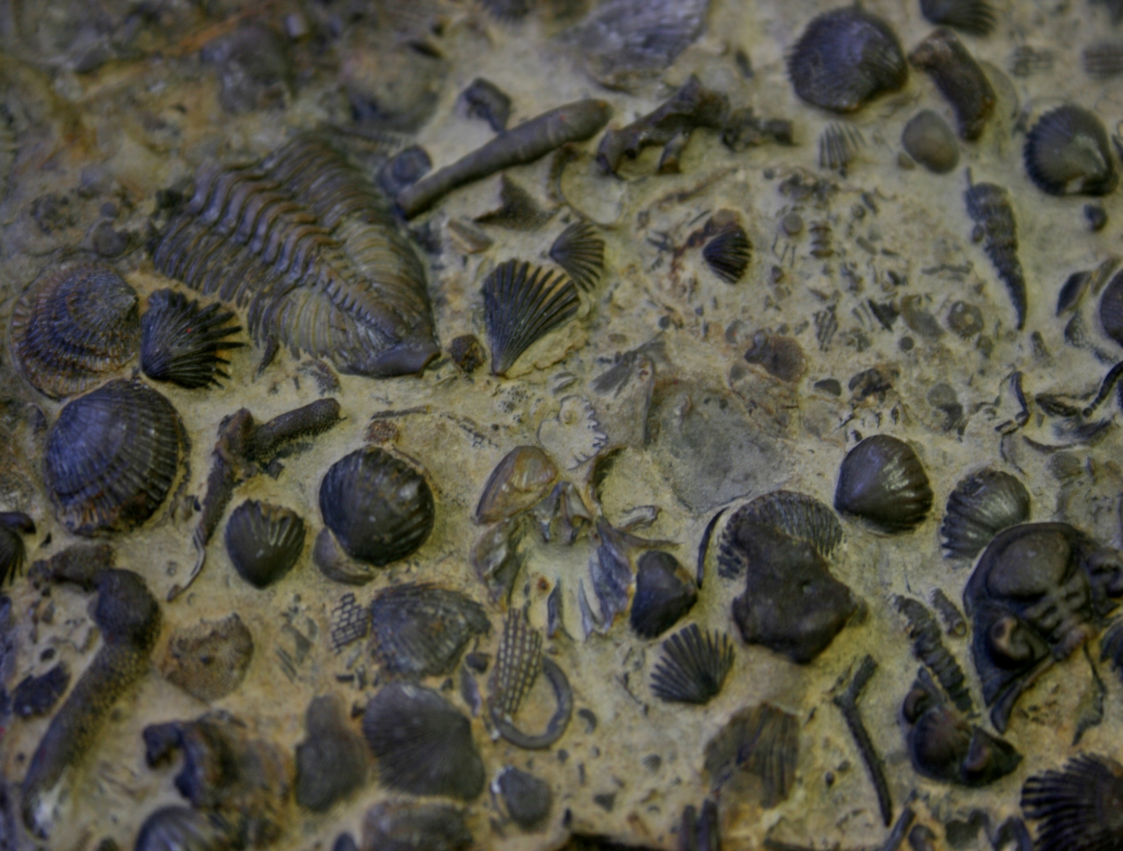
Questions?
Photo credit: Mike Peel, http://commons.wikimedia.org/wiki/File: BLW_Wenlock_limestone.jpg. Creative Commons, share alike.

